Slide 1
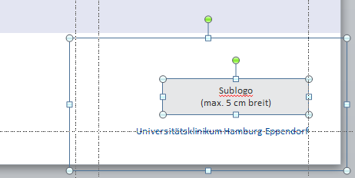
Results: Relationship between structural connectivity and functional segregation in an aging population
Research
Die Möglichkeit, ein Sublogo zu platzieren, haben Sie auch auf den anderen Titelseiten-Layouts.
Markieren Sie sich hierzu alle Elemente in der unteren rechten Ecke und kopieren Sie sie mit STRG+C.
Gehen Sie auf eines der anderen Titel-Layouts und drücken Sie STRG+V, um die Elemente an gleicher Stelle einzufügen.
Markieren Sie dann das rote Hinweisfeld an der oberen rechten Ecke und löschen es.
(Maximilian Schulz | 25.01.2021)
Universitätsklinikum Hamburg-Eppendorf

Slide 2
Alteration of Functional Connectivity with age (p – value)
36 Par | Absolut Values |  |  | Signet Values |  |  | Without negative
 | Thresh 0% | Thresh 50% | Thresh 90% | Thresh 0% | Thresh 50% | Thresh 90% | Thresh 0% | Thresh 50% | Thresh 90%
p-Value
Global mean connectivity | p = 0.045 | p = 0.04 | p = 0.14 | p = 0.9 | p =0.8 | p =0.6 | p = 0.3 | p = 0.09 | p = 0.1
Global mean within network connectivity | p = 0.024 | p = 0.72 | p = 0.17 | p < 0.001 | p < 0.001 | p =0.09 | p = 0.1 | p = 0.8 | p = 0.2
Global mean between network connectivity | p = 0.004 | p = 0.002 | p = 0.02 | p = 0.58 | p = 0.5 | p =0.5 | p < 0.001 | p = 0.007 | p = 0.015
Mean Default connectivity | p = 0.009 | p = 0.97 | p = 0.13 | p < 0.001 | p < 0.001 | p =0.02 | p = 0.025 | p = 0.4 | p = 0.09
Mean Dorsal connectivity | p = 0.04 | p = 0.69 | p = 0.34 | p < 0.001 | p = 0.003 | p =0.14 | p = 0.05 | p = 0.2 | p = 0.3
Mean Salience connectivity | p < 0.001 | p = 0.01 | p = 0.21 | p < 0.001 | p < 0.001 | p =0.06 | p < 0.001 | p < 0.001 | p = 0.1
Mean Control connectivity | p = 0.02 | p = 0.08 | p = 0.13 | p = 0.32 | p = 0.5 | p =0.8 | p = 0.01 | p = 0.1 | p = 0.2
Default betw connectivity | p = 0.003 | p = 0.002 | p = 0.03 | p = 0.02 | p = 0.035 | p =0.03 | p < 0.001 | p = 0.004 | p = 0.02
Dorsal betw connectivity | p = 0.01 | p = 0.003 | p = 0.04 | p = 0.34 | p = 0.3 | p =0.3 | p = 0.0025 | p = 0.01 | p = 0.04
Salience betw connectivity | p = 0.7 | p = 0.02 | p = 0.03 | p = 0.07 | p = 0.6 | p =0.9 | p = 0.09 | p = 0.06 | p = 0.02
Control betw connectivity | p < 0.001 | p = 0.0009 | p = 0.02 | p = 0.04 | p = 0.07 | p = 0.1 | p < 0.001 | p = 0.002 | p = 0.01
Segregation Global | p < 0.001 | p < 0.001 | p < 0.001 | p = 0.2 | p = 0.3 | p = 0.9 | p < 0.001 | p < 0.001 | p < 0.001
Segregation Association | p < 0.001 | p < 0.001 | p = 0.01 | p = 0.3 | p = 0.3 | p = 0.9 | p < 0.001 | p < 0.001 | p = 0.01
Segregation Sensory | p < 0.001 | p < 0.001 | p < 0.001 | p < 0.001 | p = 0.007 | p = 0.13 | p < 0.001 | p < 0.001 | p < 0.001
Segregation Default | p < 0.001 | p < 0.001 | p < 0.001 | p < 0.001 | p < 0.001 | p =0.002 | p < 0.001 | p < 0.001 | p < 0.001
Segregation Dorsal | p < 0.001 | p < 0.001 | p < 0.001 | p < 0.001 | p = 0.006 | p =0.01 | p < 0.001 | p < 0.001 | p < 0.001
Segregation Salience | p < 0.001 | p < 0.001 | p < 0.001 | p < 0.001 | p < 0.001 | p =0.3 | p < 0.001 | p < 0.001 | p < 0.001
Segregation Control | p = 0.5 | p = 0.02 | p = 0.6 | p = 0.8 | p = 0.2 | p =0.8 | p = 0.25 | p = 0.03 | p = 0.4
Legend | Not Sign. | Sign.
Aroma | Absolut Values |  |  | Signet Values |  |  | Without negative
 | Thresh 0% | Thresh 50% | Thresh 90% | Thresh 0% | Thresh 50% | Thresh 90% | Thresh 0% | Thresh 50% | Thresh 90%
p-Value
Global mean connectivity | p < 0.001 | p < 0.001 | p < 0.001 | p = 0.02 | p = 0.5 | p < 0.001 | p < 0.001 | p < 0.001 | p < 0.001
Global mean within network connectivity | p < 0.001 | p < 0.001 | p < 0.001 | p < 0.001 | p < 0.001 | p < 0.001 | p < 0.00 | p < 0.001 | p < 0.001
Global mean between network connectivity | p < 0.001 | p < 0.001 | p < 0.001 | p < 0.001 | p < 0.001 | p = 0.3 | p = 0.05 | p = 0.4 | p < 0.001
Mean Default connectivity | p < 0.001 | p < 0.001 | p < 0.001 | p < 0.001 | p < 0.001 | p < 0.001 | p < 0.001 | p < 0.001 | p < 0.001
Mean Dorsal connectivity | p < 0.001 | p < 0.001 | p < 0.001 | p < 0.001 | p < 0.001 | p < 0.001 | p < 0.001 | p < 0.001 | p < 0.001
Mean Salience connectivity | p < 0.001 | p < 0.001 | p < 0.001 | p < 0.001 | p < 0.001 | p < 0.001 | p < 0.001 | p < 0.001 | p < 0.001
Mean Control connectivity | p < 0.001 | p < 0.001 | p < 0.001 | p = 0.006 | p = 0.01 | p = 0.02 | p < 0.001 | p < 0.001 | p < 0.001
Default betw connectivity | p < 0.001 | p < 0.001 | p < 0.001 | p < 0.001 | p < 0.001 | p < 0.001 | p = 0.3 | p = 0.91 | p < 0.001
Dorsal betw connectivity | p < 0.001 | p < 0.001 | p < 0.001 | p = 0.132 | p = 0.185 | p = 0.3 | p < 0.001 | p = 0.003 | p < 0.001
Salience betw connectivity | p < 0.001 | p < 0.001 | p < 0.001 | p = 0.01 | p = 0.01 | p < 0.001 | p < 0.001 | p < 0.001 | p < 0.001
Control betw connectivity | p < 0.001 | p < 0.001 | p < 0.001 | p < 0.001 | p < 0.001 | p < 0.001 | p = 0.73 | p = 0.65 | p < 0.001
Segregation Global | p < 0.001 | p < 0.001 | p < 0.001 | P = 0.3 | P = 0.3 | P = 0.03 | p < 0.001 | p < 0.001 | P = 0.7
Segregation Association | p < 0.001 | p < 0.001 | P = 0.09 | P = 0.3 | P = 0.3 | P = 0.03 | p < 0.001 | p < 0.001 | P = 0.03
Segregation Sensory | p < 0.001 | p < 0.001 | p < 0.001 | P = 0.001 | P = 0.0003 | P = 0.8 | p < 0.001 | p < 0.001 | p < 0.001
Segregation Default | p < 0.001 | p < 0.001 | p = 0.35 | p < 0.001 | p < 0.001 | p = 0.04 | p < 0.001 | p < 0.001 | p = 0.052
Segregation Dorsal | p < 0.001 | p < 0.001 | p = 0.55 | p = 0.008 | p = 0.02 | p = 0.23 | p < 0.001 | p < 0.001 | p = 0.89
Segregation Salience | p < 0.001 | p < 0.001 | p = 0.002 | p = 0.9 | p = 0.9 | p = 0.02 | p < 0.001 | p < 0.001 | p < 0.001
Segregation Control | p = 0.006 | p = 0.19 | p = 0.56 | p = 0.9 | p = 0.6 | p = 0.06 | p = 0.006 | p = 0.005 | p = 0.3
Alterations of global functional connectivity and within network connectivity are less frequently observed with 36 parameter nuisance regression
Overall, changes in functional connectivity with signet matrices can be observed least frequently in both denoising methods
The alteration in functional segregation with age, especially of default, dorsal and salience network proves to be relatively robust across both denoising procedures, different matrices and thresholds.

Slide 3
Alteration of Functional Connectivity with age (Effect size)
 | Absolut Values |  |  | Signet Values |  |  | Without negative
36 Par | Thresh 0% | Thresh 50% | Thresh 90% | Thresh 0% | Thresh 50% | Thresh 90% | Thresh 0% | Thresh 50% | Thresh 90%
Std. Beta
Global mean connectivity | 0.04 | 0.04 | 0.03 | 0.003 | 0.005 | 0.01 | 0.02 | 0.04 | 0.03
Global mean within network connectivity | - 0.05 | 0.008 | 0.03 | - 0.11 | -0.08 | -0.04 | - 0.03 | - 0.005 | 0.03
Global mean between network connectivity | 0.06 | 0.07 | 0.05 | 0.011 | 0.009 | 0.015 | 0.07 | 0.06 | 0.05
Mean Default connectivity | - 0.06 | - 0.0009 | 0.03 | - 0.11 | -0.09 | - 0.05 | - 0.05 | - 0.02 | 0.04
Mean Dorsal connectivity | - 0.04 | - 0.008 | 0.02 | - 0.07 | -0.06 | - 0.03 | - 0.04 | - 0.03 | 0.02
Mean Salience connectivity | - 0.15 | - 0.05 | 0.03 | - 0.2 | 0.02 | - 0.04 | - 0.13 | - 0.07 | 0.03
Mean Control connectivity | 0.05 | 0.04 | 0.03 | 0.02 | 0.015 | - 0.006 | 0.05 | 0.03 | 0.03
Default betw connectivity | 0.06 | 0.07 | 0.05 | 0.013 | 0.04 | 0.05 | 0.09 | 0.06 | 0.05
Dorsal betw connectivity | 0.05 | 0.06 | 0.04 | 0.02 | 0.02 | 0.03 | 0.06 | 0.05 | 0.04
Salience betw connectivity | 0.007 | 0.05 | 0.05 | - 0.04 | - 0.01 | - 0.002 | 0.005 | 0.04 | 0.05
Control betw connectivity | 0.08 | 0.07 | 0.05 | 0.04 | 0.04 | 0.034 | 0.09 | 0.07 | 0.05
Segregation Global | - 0.21 | - 0.17 | - 0.09 | - 0.024 | 0.022 | - 0.0003 | - 0.17 | - 0.14 | - 0.09
Segregation Association | - 0.19 | - 0.17 | - 0.054 | - 0.023 | 0.022 | - 0.00003 | - 0.17 | - 0.14 | - 0.06
Segregation Sensory | - 0.21 | - 0.15 | - 0.13 | - 0.07 | - 0.06 | - 0.03 | - 0.17 | - 0.14 | - 0.13
Segregation Default | - 0.15 | - 0.15 | - 0.08 | - 0.09 | - 0.08 | - 0.07 | - 0.17 | - 0.14 | - 0.07
Segregation Dorsal | - 0.13 | - 0.13 | - 0.098 | - 0.07 | - 0.06 | - 0.05 | - 0.14 | - 0.13 | - 0.1
Segregation Salience | - 0.24 | - 0.21 | - 0.09 | - 0.1 | - 0.07 | - 0.23 | - 0.23 | - 0.2 | - 0.09
Segregation Control | - 0.01 | - 0.05 | - 0.012 | - 0.006 | 0.03 | - 0.005 | - 0.024 | - 0.05 | - 0.02
Legend | Not Sign. | Sign.
 | Absolut Values |  |  | Signet Values |  |  | Without negative
Aroma | Thresh 0% | Thresh 50% | Thresh 90% | Thresh 0 | Thresh 50% | Thresh 90% | Thresh 0% | Thresh 50% | Thresh 90%
Std. Beta
Global mean connectivity | -0.15 | -0.15 | -0.18 | 0.05 | 0.015 | -0.15 | -0.12 | -0.12 | -0.18
Global mean within network connectivity | -0.22 | -0.2 | -0.18 | -0.23 | -0.23 | -0.19 | -0.22 | -0.22 | -0.19
Global mean between network connectivity | -0.11 | -0.12 | -0.16 | 0.19 | 0.19 | 0.024 | -0.04 | -0.18 | -0.16
Mean Default connectivity | -0.13 | -0.14 | -0.15 | -0.13 | -0.14 | -0.15 | -0.13 | -0.13 | -0.15
Mean Dorsal connectivity | -0.13 | -0.17 | -0.19 | -0.13 | -0.16 | -0.18 | -0.14 | -0.14 | -0.18
Mean Salience connectivity | -0.036 | -0.19 | -0.18 | -0.19 | -0.19 | -0.16 | -0.19 | -0.19 | -0.18
Mean Control connectivity | -0.08 | -0.08 | -0.09 | -0.06 | -0.05 | -0.05 | -0.08 | -0.07 | -0.09
Default betw connectivity | -0.1 | -0.12 | -0.16 | 0.12 | 0.12 | 0.08 | -0.02 | 0.0005 | -0.15
Dorsal betw connectivity | -0.12 | -0.14 | -0.17 | 0.03 | 0.03 | -0.02 | -0.08 | -0.06 | -0.18
Salience betw connectivity | -0.12 | -0.13 | -0.16 | -0.05 | -0.05 | -0.09 | -0.09 | -0.08 | -0.16
Control betw connectivity | -0.07 | -0.1 | -0.15 | 0.16 | 0.17 | 0.07 | -0.007 | 0.009 | -0.15
Segregation Global | - 0.21 | - 0.23 | - 0.09 | -0.02 | - 0.02 | 0.05 | - 0.22 | - 0.23 | -0.05
Segregation Association | - 0.19 | - 0.17 | - 0.04 | - 0.02 | - 0.02 | 0.05 | - 0.19 | - 0.20 | -0.007
Segregation Sensory | - 0.21 | - 0.21 | - 0.2 | - 0.07 | - 0.08 | - 0.007 | - 0.23 | - 0.23 | - 0.12
Segregation Default | -0.09 | -0.08 | 0.02 | -0.09 | -0.08 | -0.04 | -0.12 | -0.12 | 0.04
Segregation Dorsal | -0.08 | -0.09 | -0.04 | -0.06 | -0.05 | -0.025 | -0.09 | -0.1 | 0.001
Segregation Salience | -0.2 | -0.18 | -0.07 | 0.002 | 0.004 | 0.05 | -0.18 | -0.18 | -0.08
Segregation Control | -0.06 | -0.03 | -0.013 | -0.001 | 0.009 | 0.04 | -0.06 | -0.06 | 0.02
Functional connectivity between resting state networks increases with age after denoising with 36 parameters. After denoising with ICA, the connectivity between the networks decreases with age.
The decrease in functional segregation with age of default, dorsal and salience network can be observed across both denoising procedures, different matrices and thresholds.

Slide 4
Both denoising methods, 36P and ICA-Aroma achieve excellent results in various benchmark studies; in addition, we have used global signal regression in both methods.
Global signal regression leads to a drastic increase in negative correlations, and it is not clear whether these reflect biological conditions.
Past studies dealing with functional segregation used matrices in which negative correlations were excluded
(Chan et al. 2014; Madden et al. 2020; T. Kong et al. 2019; R. Pedersen 2021)
Many studies use a threshold between 0.5 - 0.7 and some use no threshold at all.
My recommendation is to use matrices with only positive correlations and apply a threshold of 0.5. For the sake of continuity, I would continue to use ICA-Aroma.
Sample Characteristics (N=2601)
Female sex [n, (%)] | 443 (45.4%)
Age [years], median (IQR) | 65 (14)
TMT B Score [seconds], median (IQR) | 89 (37)
Structural MRI measures
Structural connectivity, median (IQR) | 0.000217 (0.00005)

Slide 5
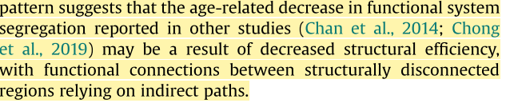
Age related decline in structural connectivity is consistent across studies, functional connectivity between cortical regions rely on multiple white matter pathways (Damoiseaux and Greicius, 2009) and increases and decreases in FC have been observed with age in different regions (Betzel et al., 2014; Biswal et al., 2010…
Functional connectivity between modules is better preserved as a function of age than within-module connectivity particularly for modules in association cortex and more prominent for individuals over 50 years of (Chong et al. 2019; Chan et al. 2014)
Functional modules become less distinct or separate with increasing age, expressed in graph theoretical terms as decreased modularity and system segregation, based on measures of within-module and between-module connectivity (Bagarinao et al., 2019; Betzel et al., 2014)
Age-related decrease in functional system segregation may be a result of decreased structural efficiency, with functional connections between structurally disconnected regions relying on indirect paths (Madden et al. 2020)
Hypothesis: Functional connectivity is disrupted through degenerated direct white matter path inhibits direct functional connections, but could be preserved by indirect pathways which might involve more regions from different functional networks leading to less segregation

Slide 6
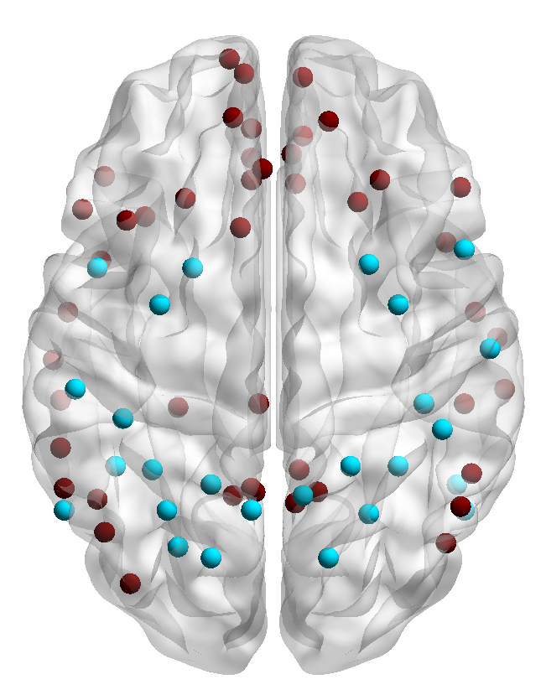
Default
Dorsal
Disrupted structural connectivity leading to
Decreasing within network connectivity
Compensated by between network connectivity = or
Decreasing functional segregatoin and dedifferentiation of resting state networks

Slide 7
First, can a relationship between decreasing structural integrity and functional segregation be observed globally and in individual networks, and is there an impact of segregation on executive cognition?
Second, based on the theory described above, can functional segregation better detect the influence of structural decline on functional alterations than functional connectivity?
Univariate:
influence of age on structural and functional connectivity, as well as on functional segregation and executive function
Multiple regression global:
direct influence of structural connectivity on functional connectivity and functional segregation
Mediation analysis global and networks:
of structural connectivity between age and functional connectivity or functional segregation
Multiple regression global:
direct influence of functional connectivity and functional segregation on TMTB score
Mediation analysis global and networks:
of functional segregation between age and TMTB score

Slide 8
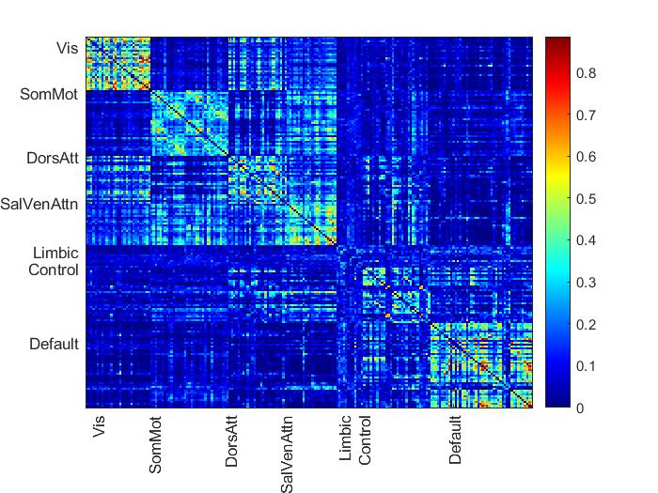
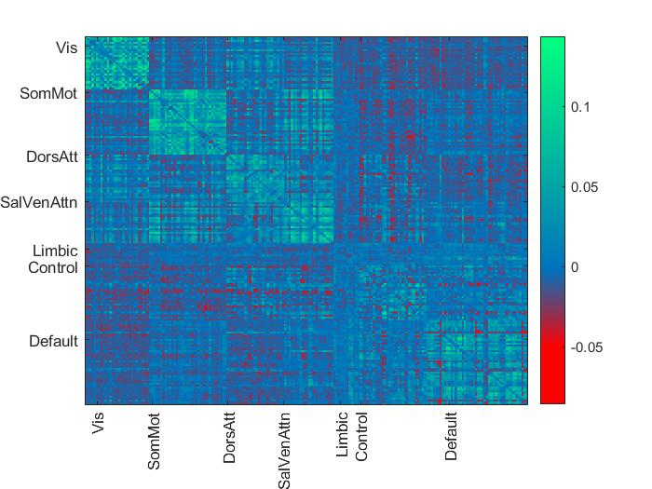
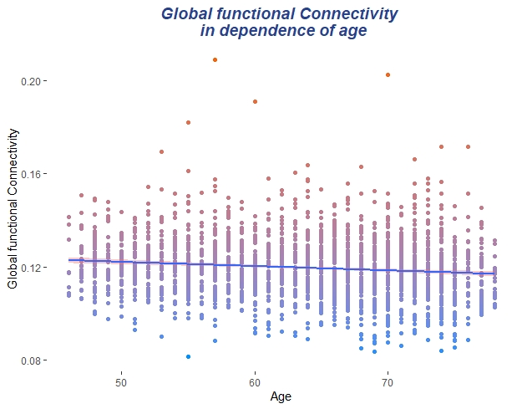
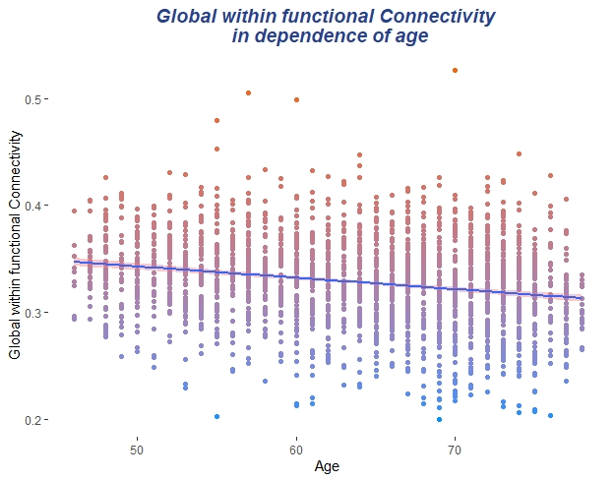
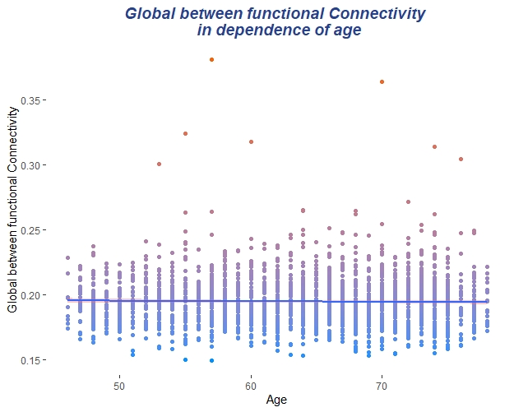
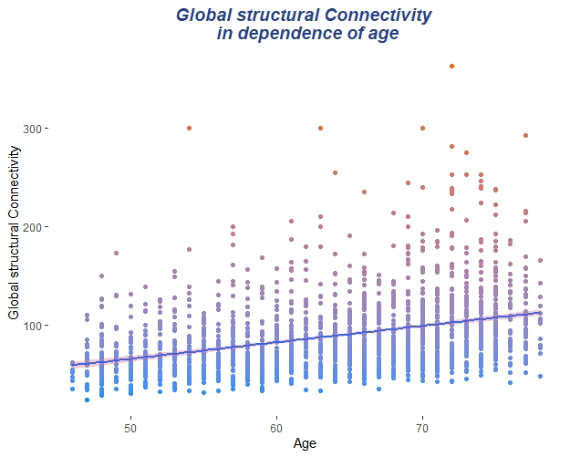
Aroma
Std. Beta | Std. Beta | p -Value | R²
Global mean connectivity | -0.12 | p < 0.001 | 0.014
Global mean within network connectivity | -0.22 | p < 0.001 | 0.047
Global mean between network connectivity | -0.18 | p = 0.4 | 0.001
Mean Default connectivity | -0.13 | p < 0.001 | 0.03
Mean Dorsal connectivity | -0.14 | p < 0.001 | 0.02
Mean Salience connectivity | -0.19 | p < 0.001 | 0.04
Mean Control connectivity | -0.07 | p < 0.001 | 0.008
Mean Limbic connectivity | 0.03 | p = 0.18 | 0.0008
Mean Sommot connectivity | -0.16 | p < 0.001 | 0.04
Mean Visaul connectivity | -0.16 | p < 0.001 | 0.03
Default betw connectivity | 0.0005 | p = 0.91 | 0.004
Dorsal betw connectivity | -0.06 | p = 0.003 | 0.009
Salience betw connectivity | -0.08 | p < 0.001 | 0.007
Control betw connectivity | 0.009 | p = 0.65 | 0.0001
Limbic betw connectivity | 0.06 | P = 0.005 | 0.004
Sommot betw connectivity | - 0.005 | P = 0.8 | 0.001
Visaul betw connectivity | 0.012 | P = 0.6 | 0.0003
Segregation Global | - 0.23 | p < 0.001 | 0.054
Segregation Association | - 0.20 | p < 0.001 | 0.04
Segregation Sensory | - 0.23 | p < 0.001 | 0.06
Segregation Default | -0.12 | p < 0.001 | 0.04
Segregation Dorsal | -0.1 | p < 0.001 | 0.014
Segregation Salience | -0.18 | p < 0.001 | 0.03
Segregation Control | -0.06 | p = 0.005 | 0.006
Segregation Limbic | 0.005 | P = 0.8 | 0.00005
Segregation Sommot | -0.18 | p < 0.001 | 0.05
Segregation Visual | -0.18 | p < 0.001 | 0.03
TMTB | 0.4 | p < 0.001 | 0.14
Decreasing Connectivity
No change
Increasing Connectivity

Slide 9
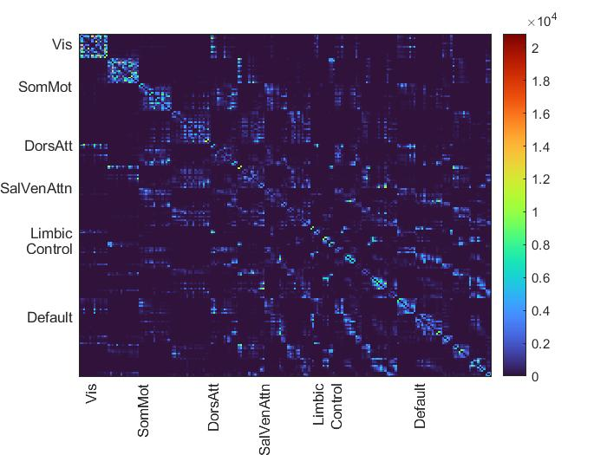
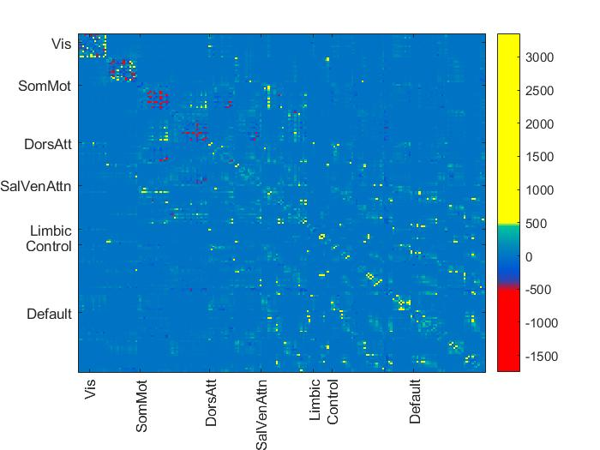
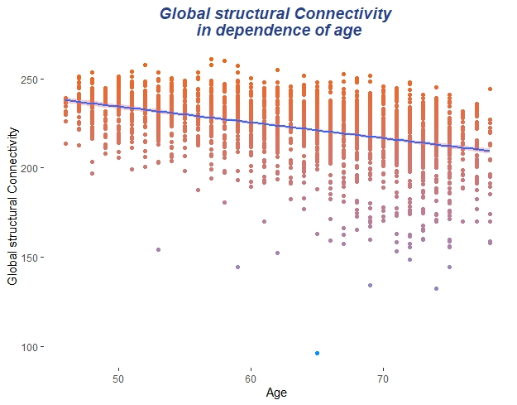
Aroma
Std. Beta | Std. Beta | p -Value | R²
Global mean str connectivity | -0.42 | p < 0.001 | 0.18
Mean Default str connectivity | -0.15 | p < 0.001 | 0.1
Mean Dorsal str connectivity | -0.23 | p < 0.001 | 0.05
Mean Salience str connectivity | -0.35 | p < 0.001 | 0.14
Mean Control str connectivity | -0.05 | p = 0.02 | 0.02
Mean Limbic str connectivity | 0.11 | p < 0.001 | 0.13
Mean Sommot str connectivity | 0.12 | p < 0.001 | 0.03
Mean Visaul str connectivity | 0.04 | p = 0.08 | 0.002

Slide 10
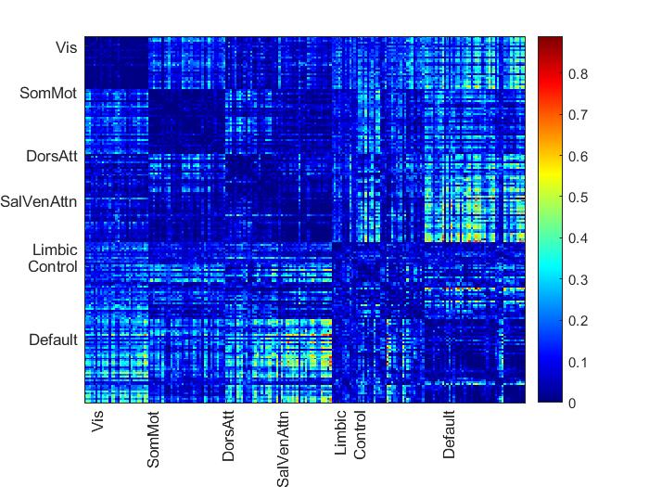
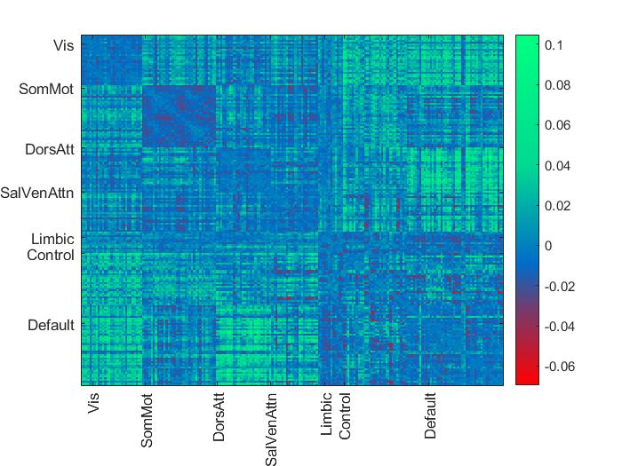
Aroma Anticorrelation
Std. Beta | Std. Beta | p -Value | R²
Global mean anti connectivity | - 0.16 | p < 0.001 | 0.03
Global mean anti within network connectivity | 0.03 | P = 0.2 | 0.004
Global mean anti between network connectivity | - 0.13 | p < 0.001 | 0.02

Slide 11
Multiple Regression: Influence of structural connectivity on functional parameters, adjusted for age and sex
 | Std. Beta | p-Value | R²
Global mean connectivity | - 0.00098 | p = 0.97 | 0.01
Global within connectivity | 0.03 | p = 0.3 | 0.05
Global between connectivity | - 0.04 | p = 0.1 | 0.002
Global segregation | 0.06 | p = 0.01 | 0.06
Global segregation associative | 0.04 | p = 0.054 | 0.04
Global segregation sensory | 0.05 | p = 0.03 | 0.06
Global mean connectivity appears to be a less sensitive indicator of functional alteration
Decreasing structural connectivity has a direct influence on functional segregation, which appears to be the more robust and sensitive marker for functional alteration.

Slide 12
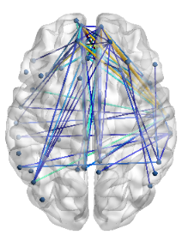
Mediation Analysis: Structural connectivity of functional networks as a mediator between age and functional segregation (Global)
a*b
Global structural connectivity shows an effect as a mediator between age and global segregation; but not between age and overall global connectivity, between-network connectivity, or within-network connectivity. (data not shown)
Global Structural Connectivity
a
b
Age
Global Functional Segregation
Global Functional Connectivity
Global Functional within connectivity
Global Functional between connectivity
c
Mediation Model Global Std. Beta p – Value Std. Error
Indirect Effect | - 0.023 | 0.03 | < 0.001
Direct Effect | - 0.209 | < 0.001 | < 0.001
Total Effect | - 0.232 | < 0.001 | = 0.001

Slide 13
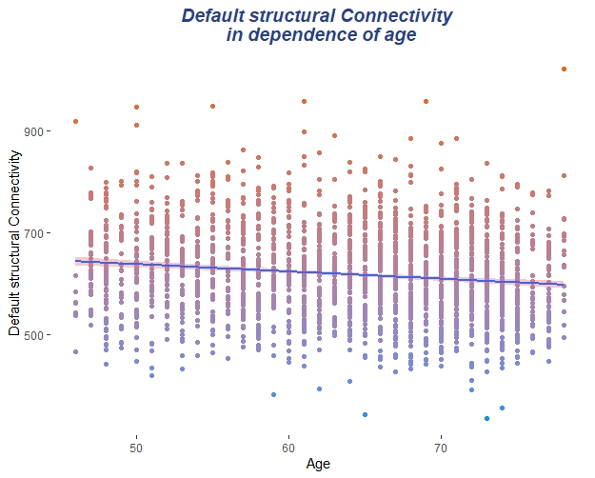
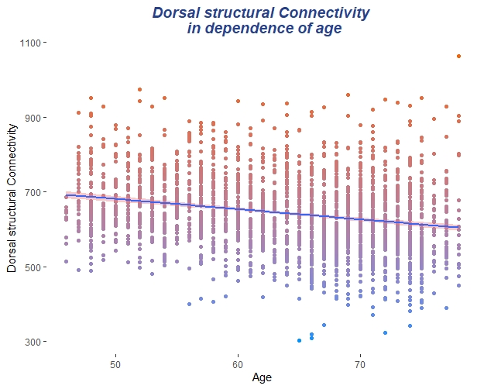
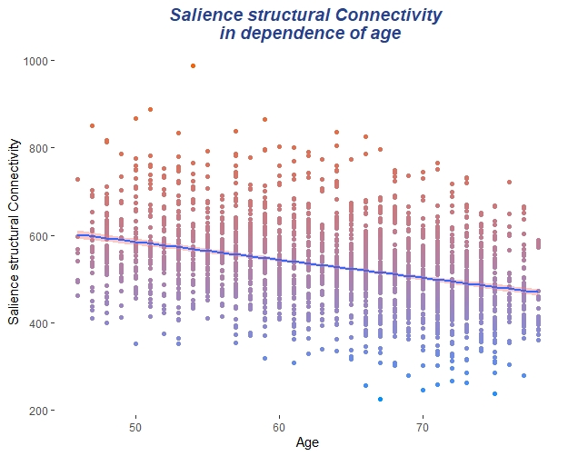
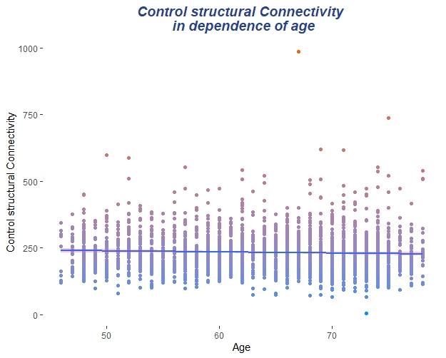
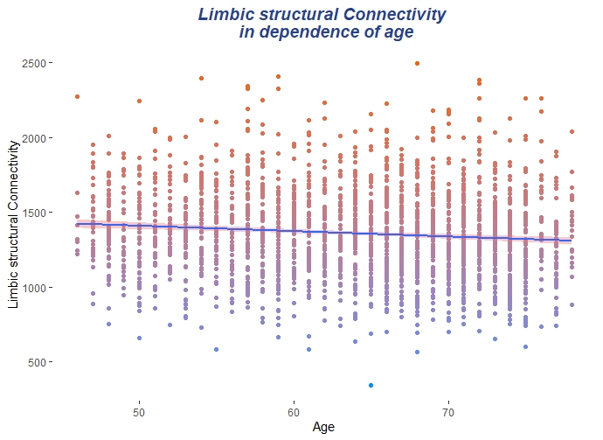
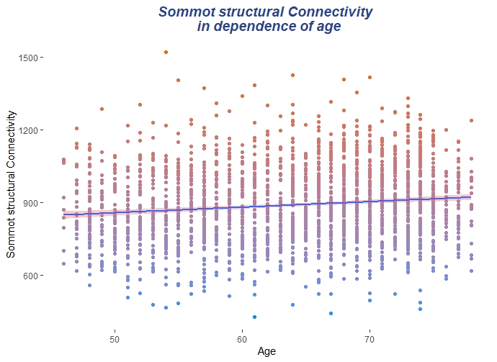
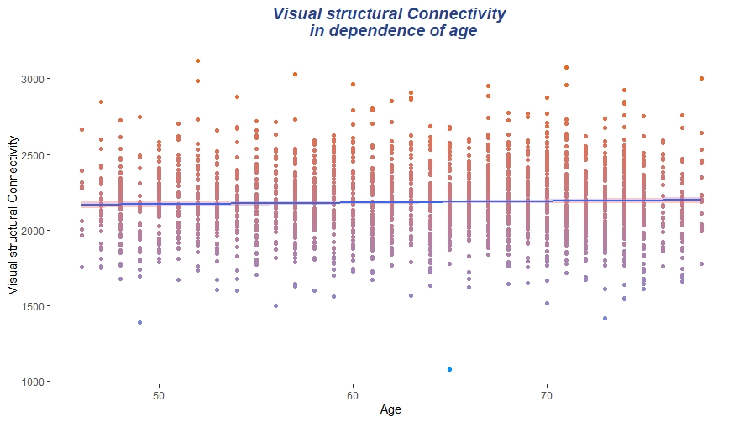
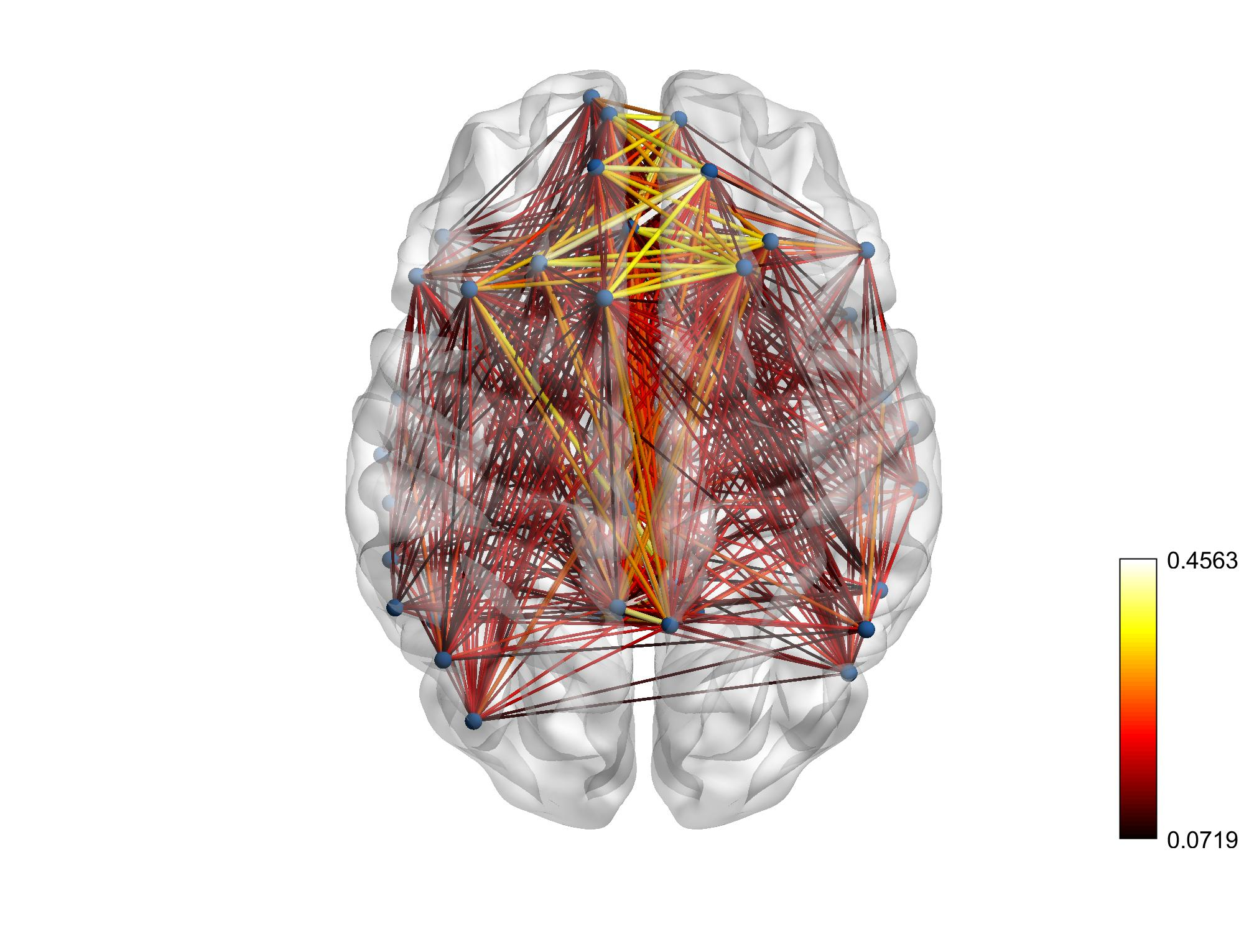
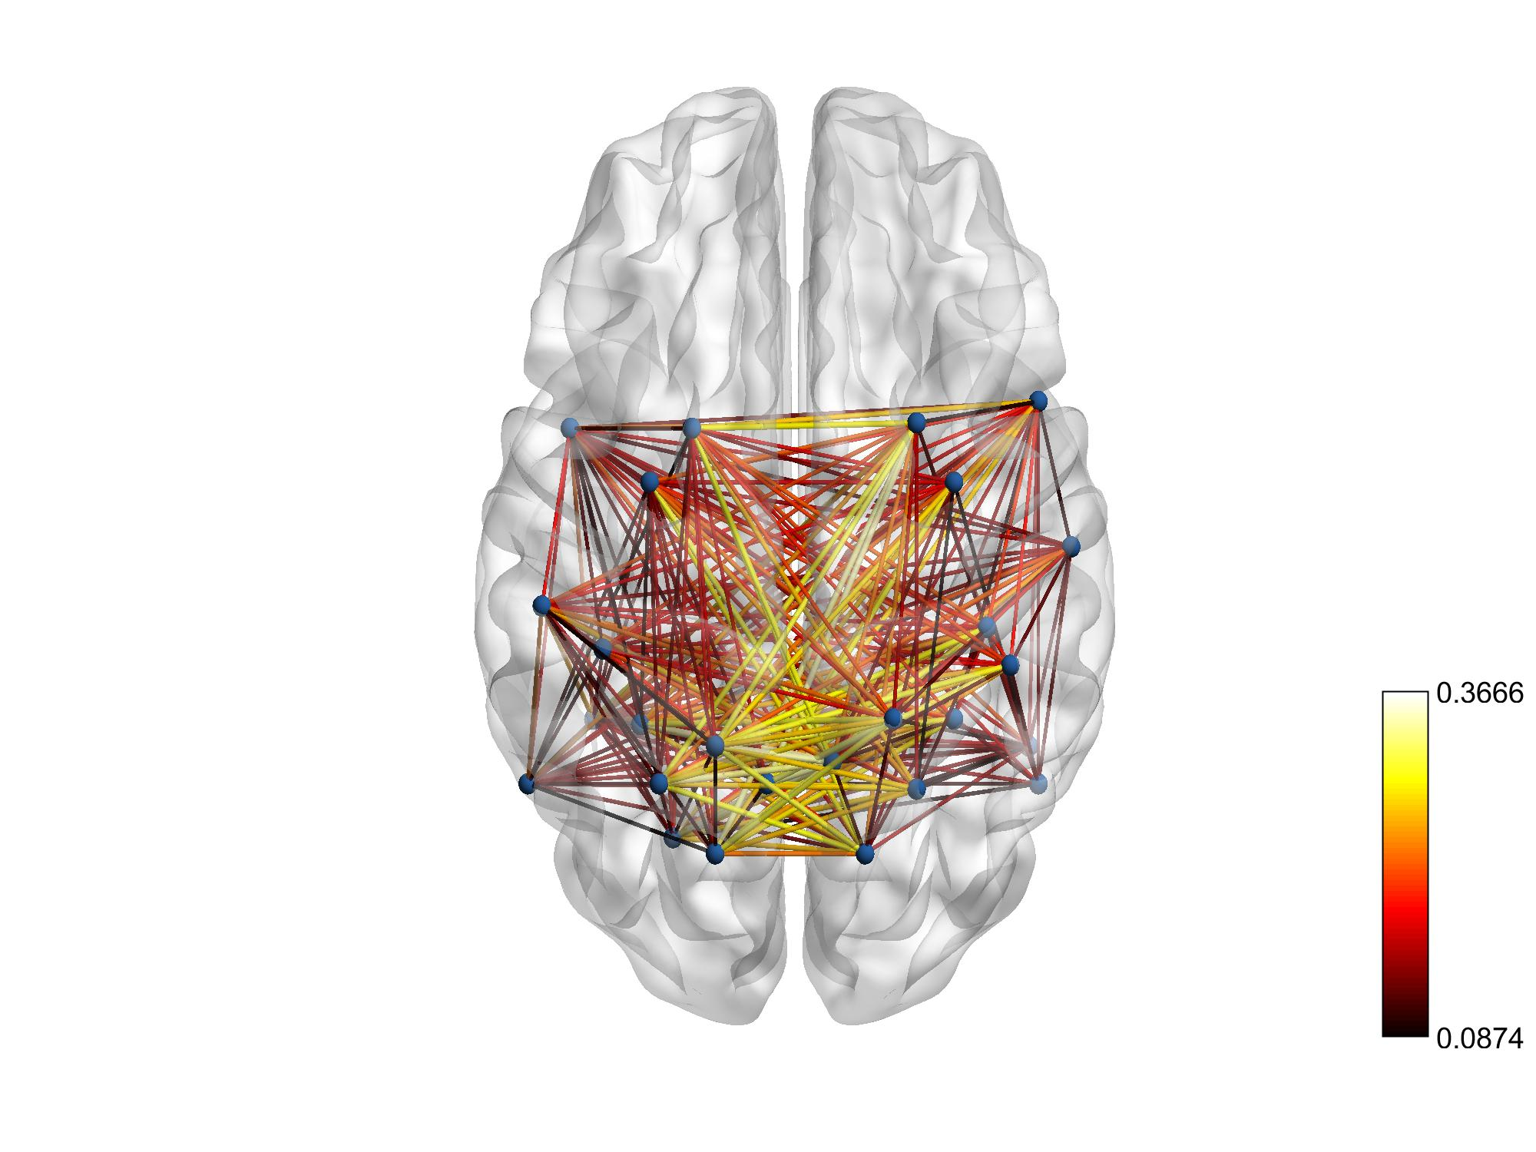
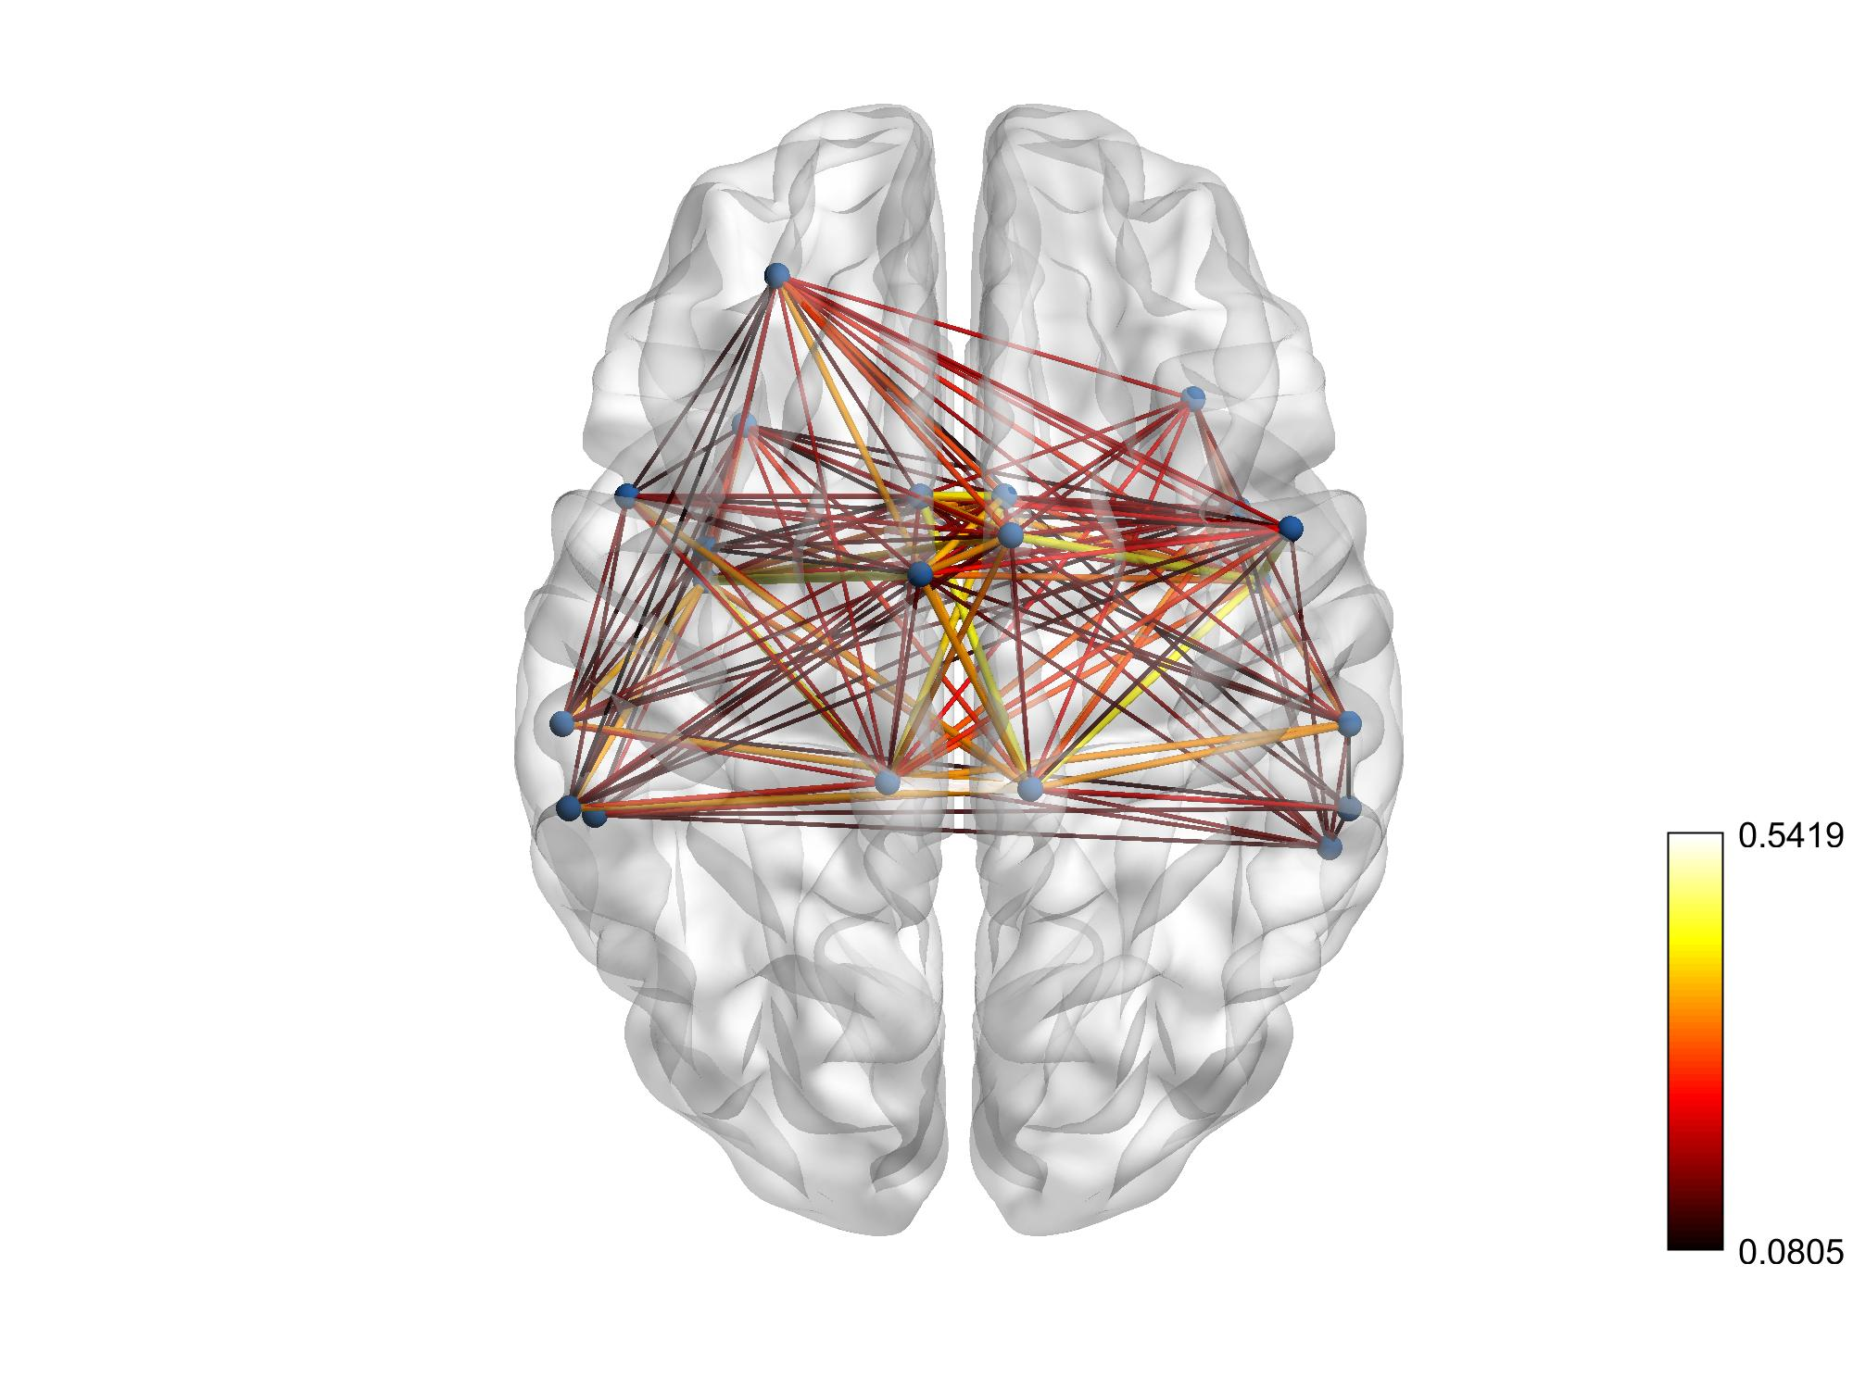
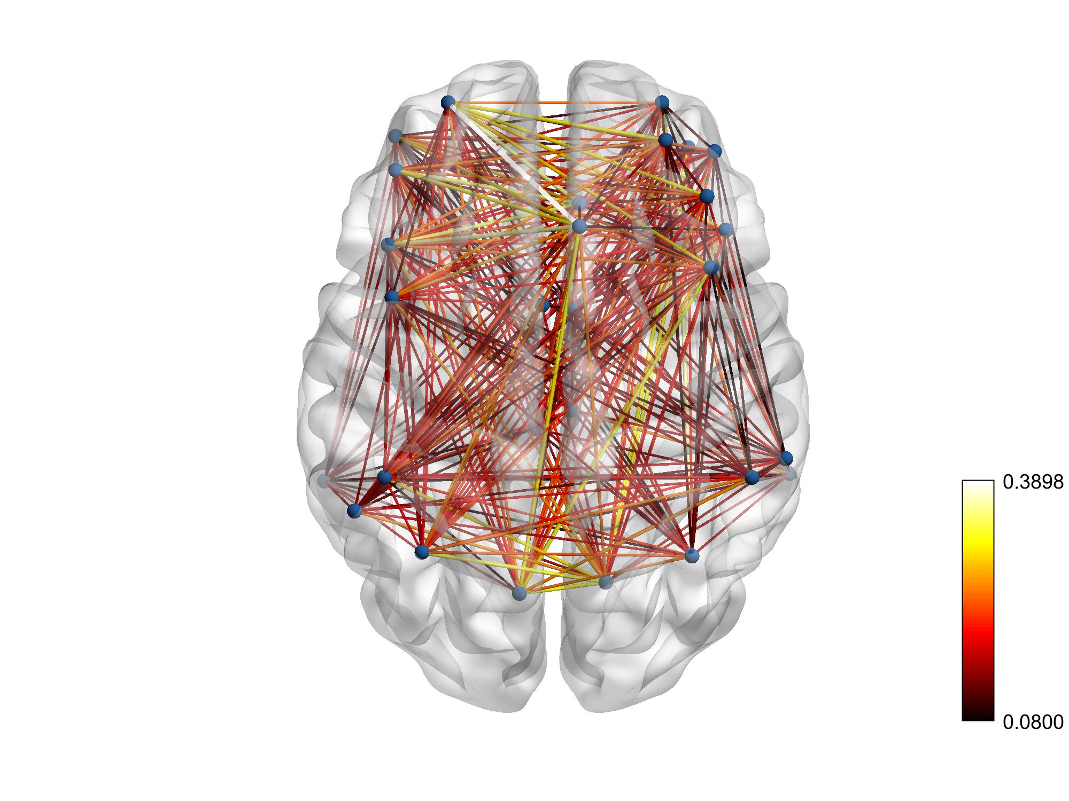
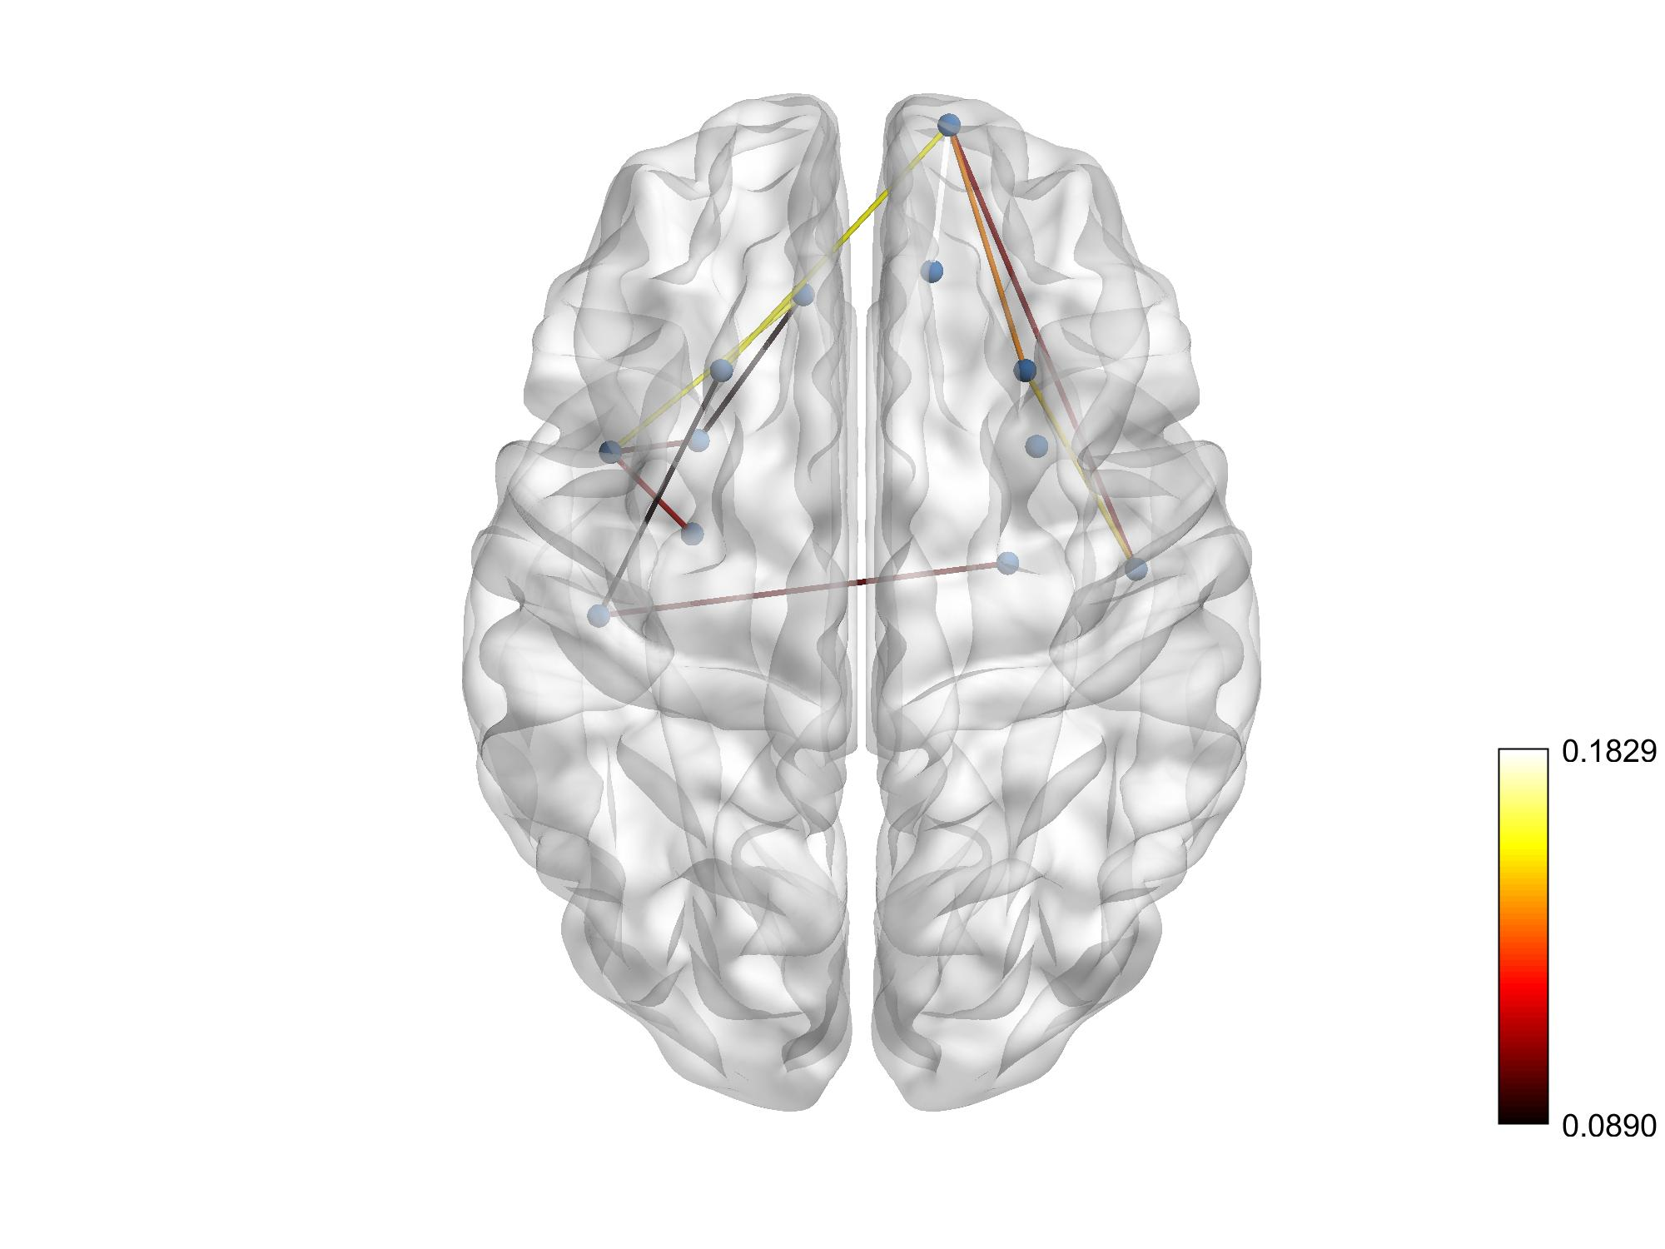
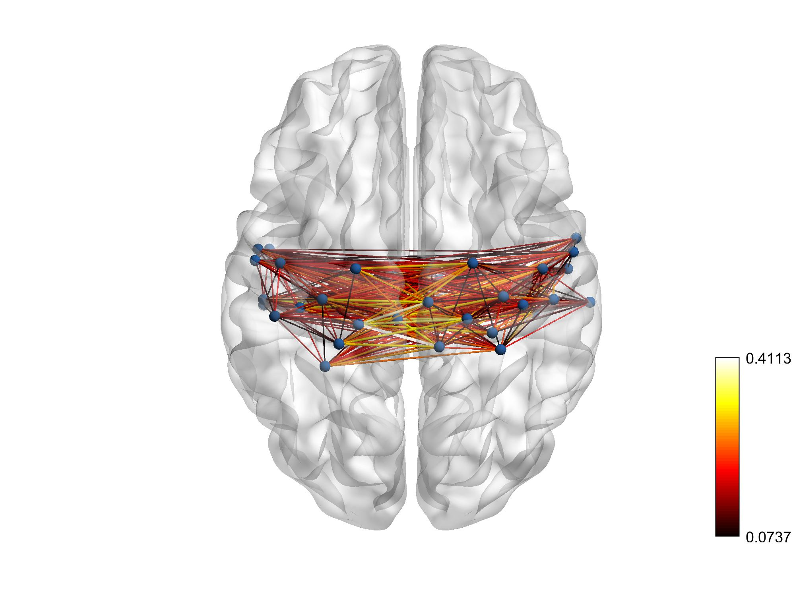
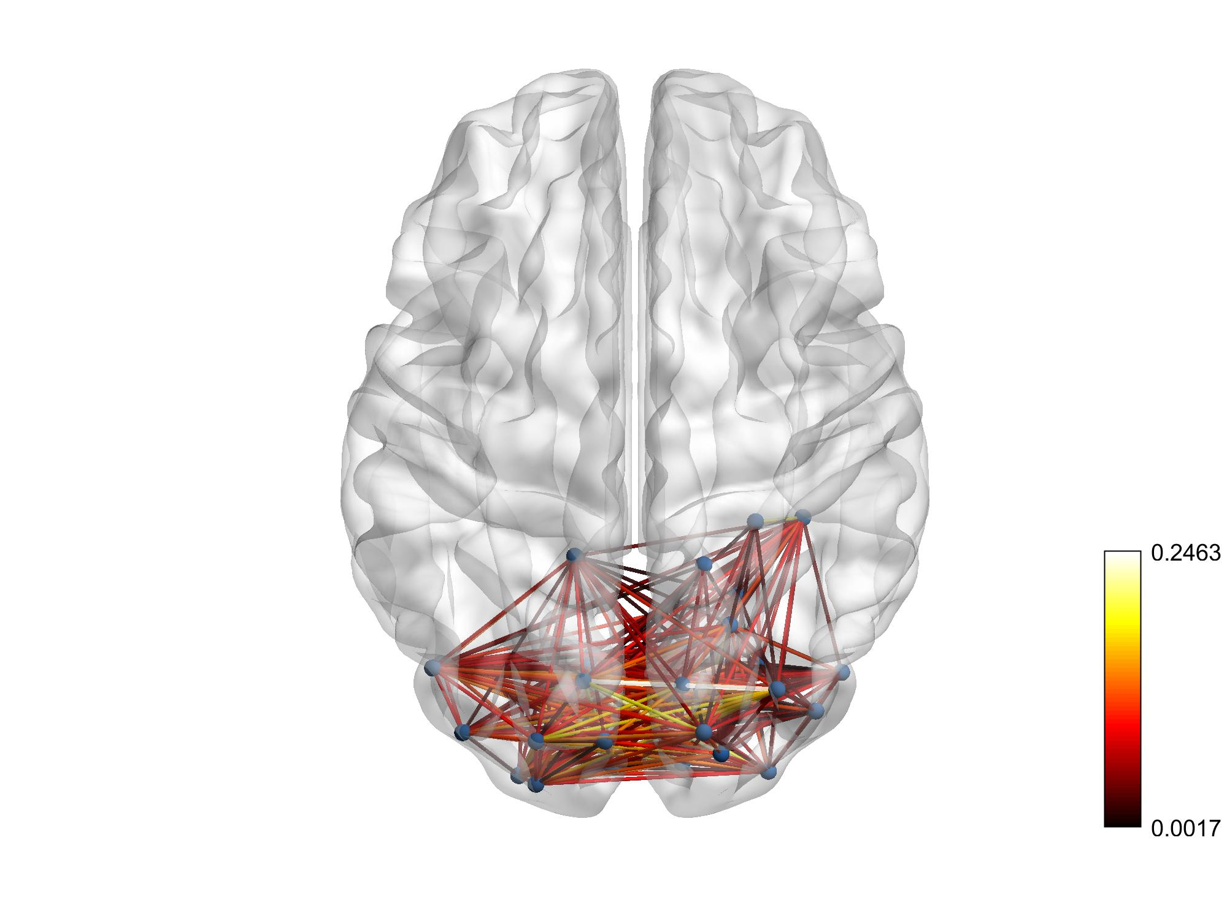
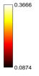
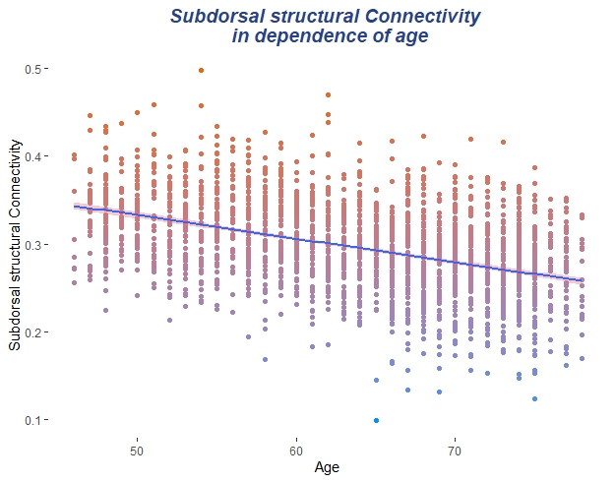
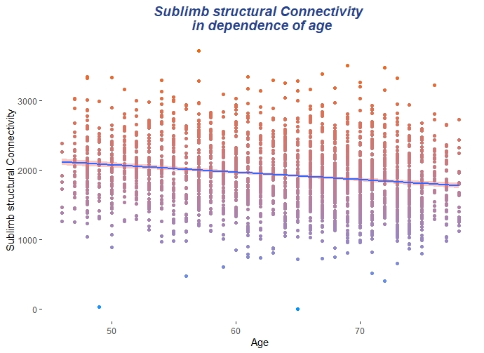
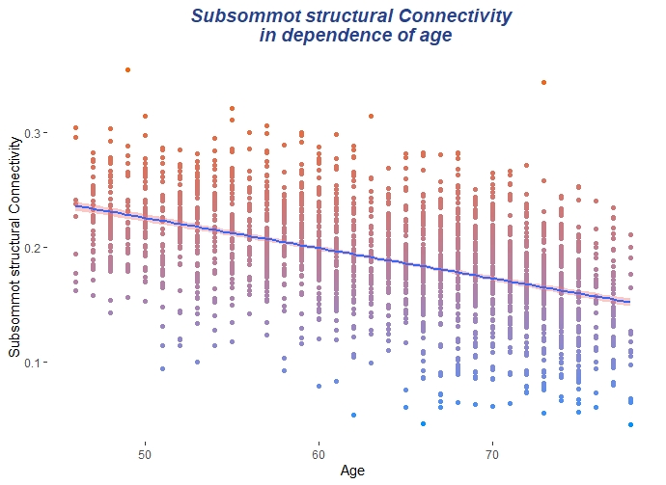
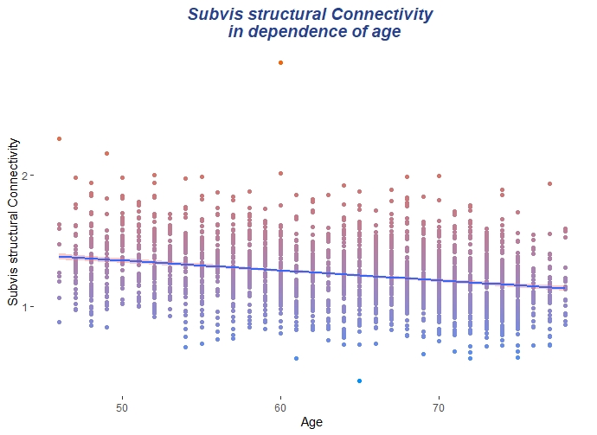
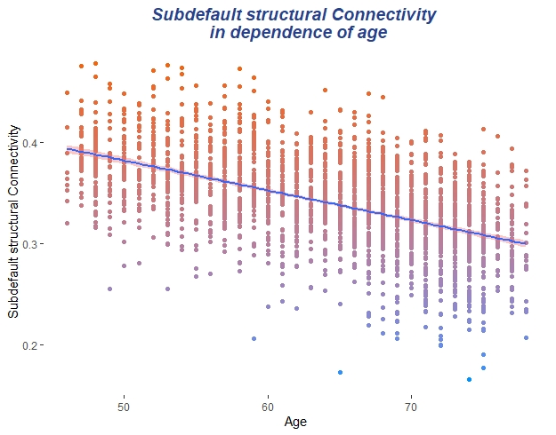
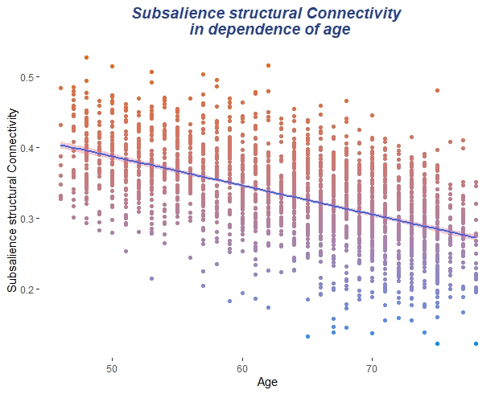
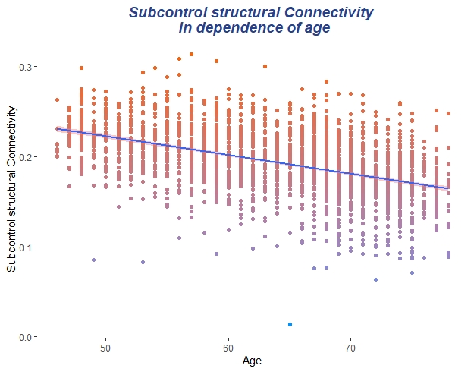
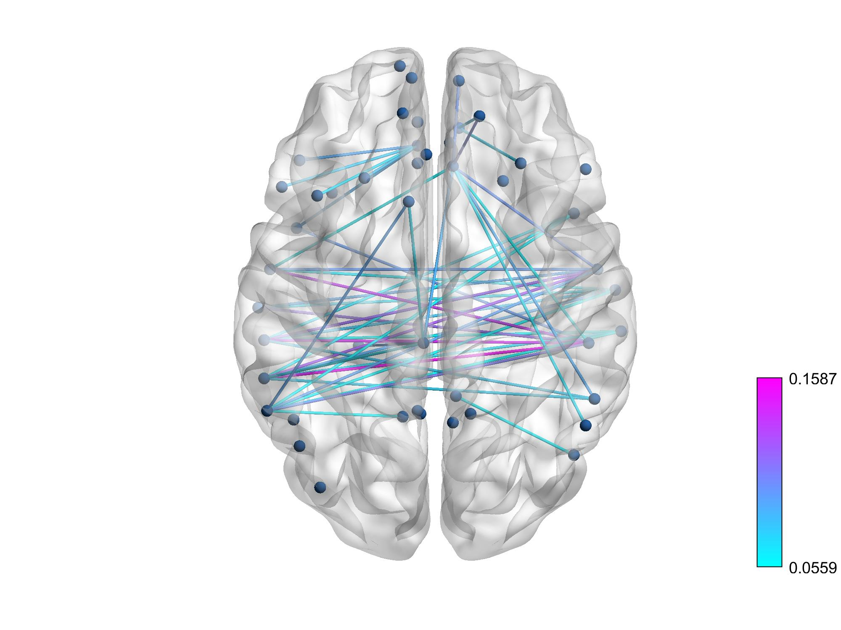
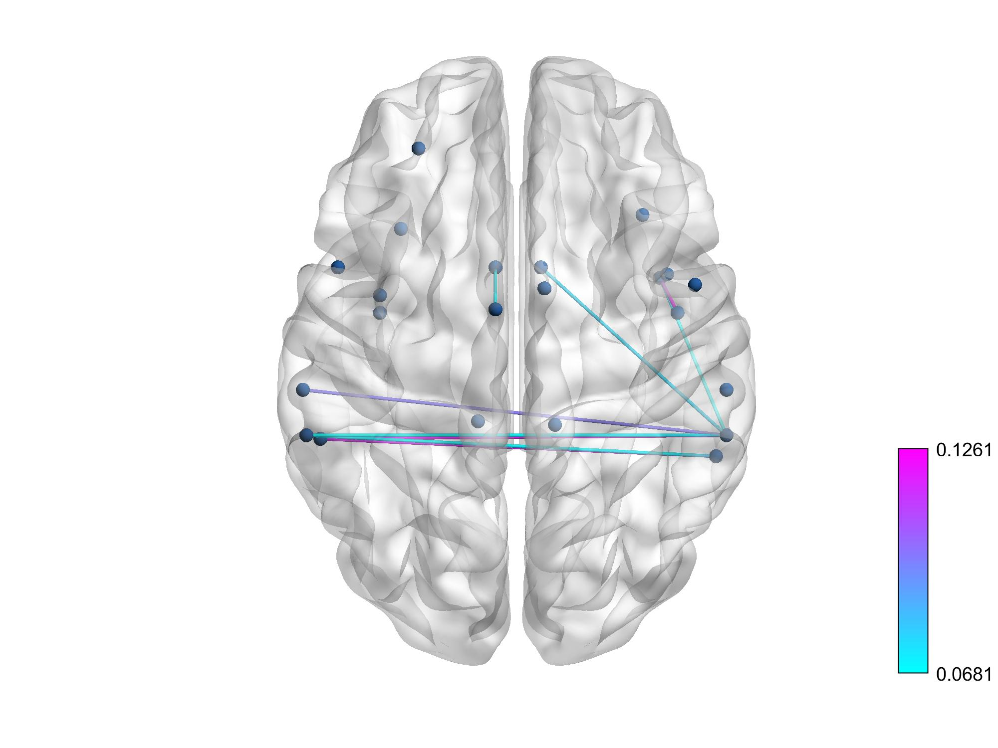
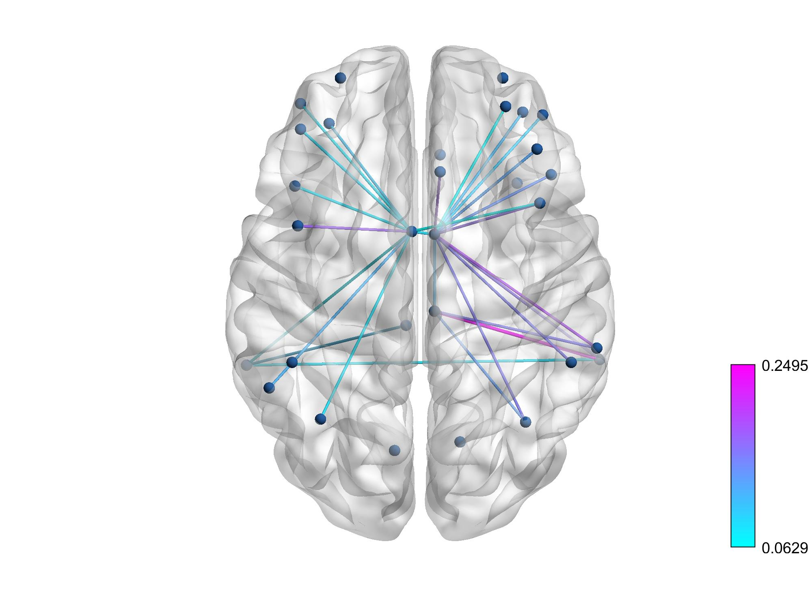
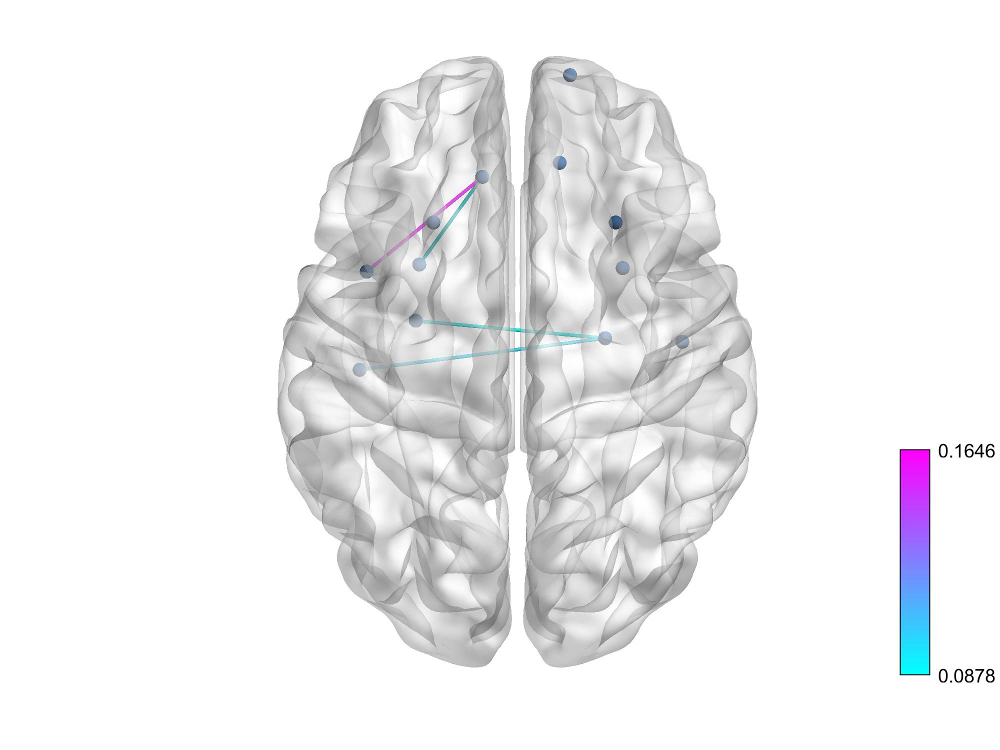
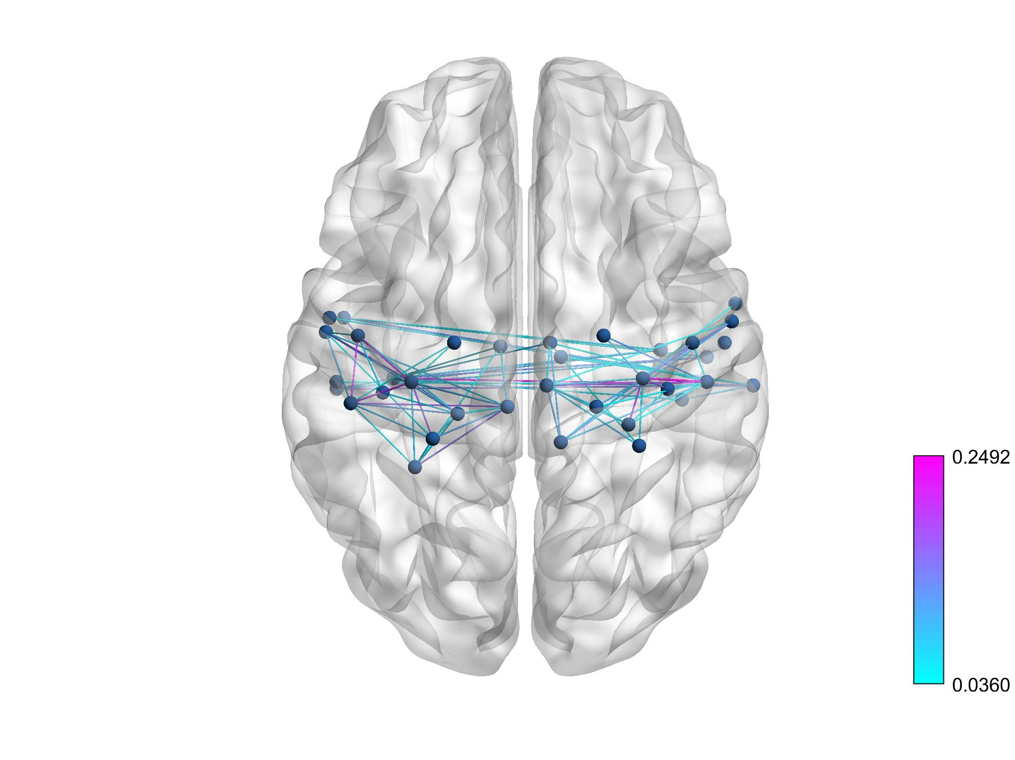
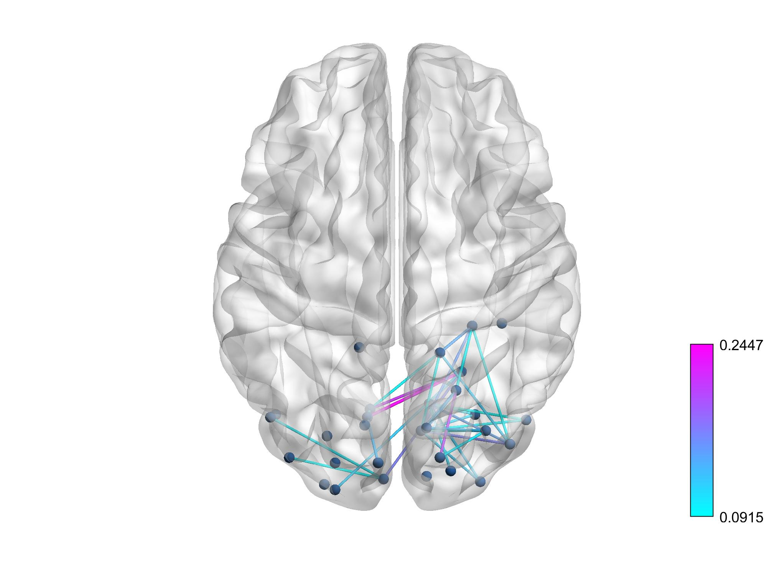
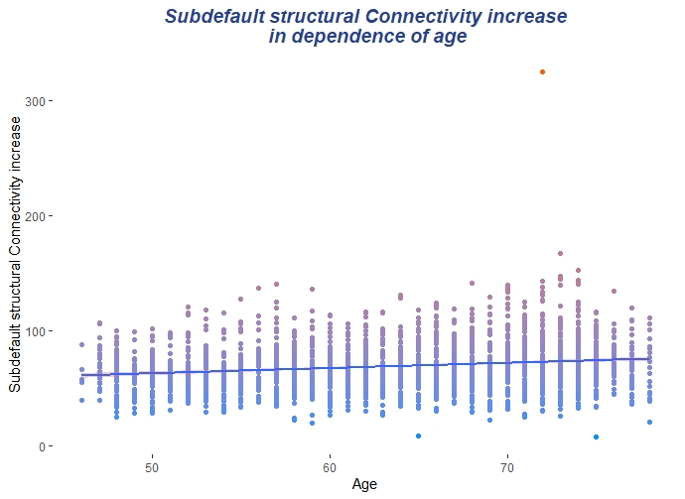
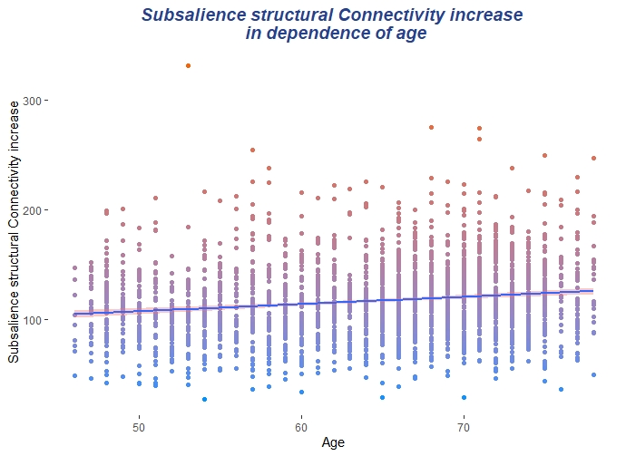
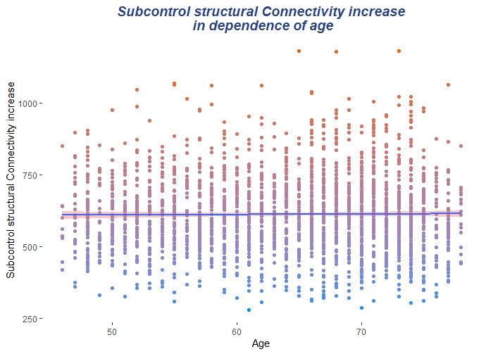
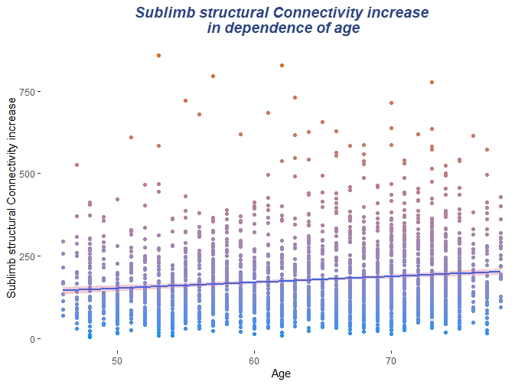
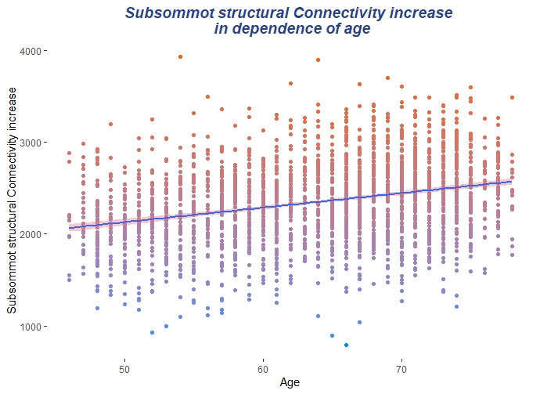
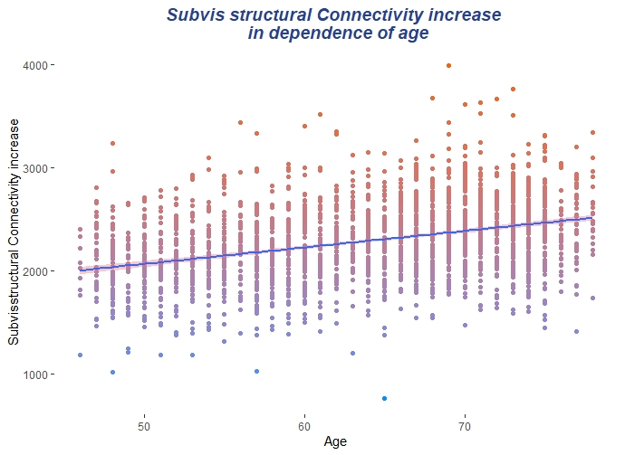

Slide 14
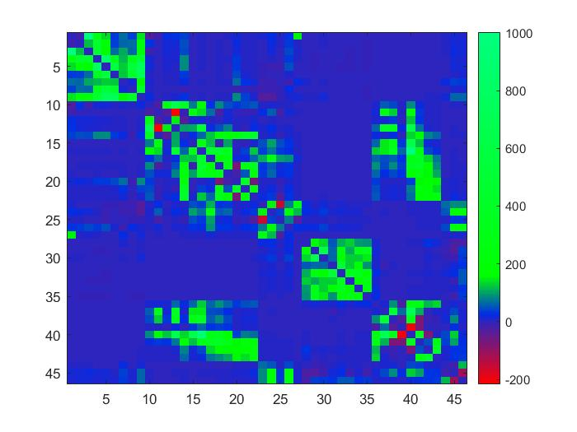

Difference maps of structural connectivity from Default and Somamotric network, based on the absolute difference of mean connectivity between the first and third age quartile
Default
Sommot
Decreasing
Decreasing
Increasing
Increasing

Slide 15
Mediation Analysis: Structural connectivity of functional networks as a mediator between age and functional segregation in associative networks
Default
Dorsal
Salience
Control
Limbic
a*b
Mediation Model Default Std. Beta p – Value Std. Error
Indirect Effect | - 0.05 | < 0.001 | < 0.001
Direct Effect | - 0.08 | = 0.001 | < 0.001
Total Effect | - 0.13 | < 0.001 | < 0.001
Mediation Model Dorsal Std. Beta p – Value Std. Error
Indirect Effect | - 0.035 | = 0.001 | < 0.001
Direct Effect | - 0.065 | = 0.003 | < 0.001
Total Effect | - 0.1 | < 0.001 | < 0.001
Mediation Model Salience Std. Beta p – Value Std. Error
Indirect Effect | - 0.067 | < 0.001 | < 0.001
Direct Effect | - 0.117 | < 0.001 | < 0.001
Total Effect | - 0.184 | < 0.001 | < 0.001
Mediation Model Control Std. Beta p – Value Std. Error
Indirect Effect | 0.001 | 0.9 | < 0.001
Direct Effect | - 0.059 | 0.016 | < 0.001
Total Effect | - 0.058 | 0.007 | = 0.001
Mediation Model Limbic Std. Beta p – Value Std. Error
Indirect Effect | - 0.023 | 0.03 | < 0.001
Direct Effect | - 0.209 | < 0.001 | < 0.001
Total Effect | - 0.232 | < 0.001 | = 0.001
Structural Subnetwork
a
b
Segregation Default
Segregation Dorsal
Segregation Salience
Segregation Control
Segregation Limbic
Age
Functional Segregation
c
Declining network-specific structural connectivity, acts as a mediator between age and declining network-specific functional segregation in all associative networks; except the Control and Limbic network.
Declining network-specific structural connectivity showed no mediation effect between age and network–specific functional connectivity
Neither network-specific structural overall network connectivity nor increasing structural connectivity showed mediation effects.

Slide 16
Mediation Analysis: Structural connectivity of functional networks as a mediator between age and functional segregation in sensory networks
Declining network-specific structural connectivity, of sensory networks showed no mediation effect between age and declining network-specific functional segregation.
Declining network-specific structural connectivity showed no mediation effect between age and network–specific functional connectivity
Neither network-specific structural overall network connectivity nor increasing structural connectivity showed mediation effects.
a*b
Sommot
Visual
Structural Subnetwork
a
b
Age
Functional Segregation
c
Segregaiont Sommot
Segregation Visual
Mediation Model Sommot Std. Beta p – Value Std. Error
Indirect Effect | 0.016 | 0.15 | < 0.001
Direct Effect | - 0.2 | < 0.001 | < 0.001
Total Effect | - 0.18 | < 0.001 | = 0.001
Mediation Model Visual Std. Beta p – Value Std. Error
Indirect Effect | 0 | 0.9 | 0.018
Direct Effect | -0.176 | < 0.001 | < 0.001
Total Effect | -0.176 | < 0.001 | = 0.001

Slide 17
Multiple Regression: Influence of functional segregation on TMTB score, adjusted for age, sex, structural connectivity
 | Std. Beta | p-Value | R²
Global segregation | - 0.06 | p = 0.007 | 0.14
Default segregation | 0.07 | p < 0.001 | 0.15
Dorsal segregation | - 0.009 | p = 0.7 | 0.14
Salience segregation | - 0.05 | p = 0.02 | 0.15
Control segregation | 0.03 | p = 0.12 | 0.14
Functional segregation has a direct impact on TMTB score, independent of age and structural connectivity. On a global level, segregation is the only functional parameter that predicts cognition.(data not shown)

Slide 18
Mediation Analysis: Functional segregation as a mediator between age and TMTB, with structural a connectivity as confounder
Segregation Global
Segregation Default
Segregation Dorsal
Segregation Salience
Segregation Control
a*b
Mediation Model Default Std. Beta p – Value Std. Error
Indirect Effect | 0.008 | 0.007 | 0.014
Direct Effect | 0.320 | < 0.001 | 0.112
Total Effect | 0.320 | < 0.001 | 0.112
Mediation Model Dorsal Std. Beta p – Value Std. Error
Indirect Effect | 0.00 | 0.8 | 0.227
Direct Effect | 0.325 | < 0.001 | 0.103
Total Effect | 0.325 | < 0.001 | 0.103
Mediation Model Salience Std. Beta p – Value Std. Error
Indirect Effect | 0.008 | 0.06 | 0.018
Direct Effect | 0.273 | < 0.001 | 0.112
Total Effect | 0.281 | < 0.001 | 0.110
Mediation Model Control Std. Beta p – Value Std. Error
Indirect Effect | 0.001 | 0.9 | < 0.001
Direct Effect | - 0.059 | 0.016 | < 0.001
Total Effect | - 0.058 | 0.007 | = 0.001
Mediation Model Global Std. Beta p – Value Std. Error
Indirect Effect | 0.013 | 0.01 | 0.023
Direct Effect | 0.324 | < 0.001 | 0.102
Total Effect | 0.337 | < 0.001 | 0.101
Segregation Subnetwork
a
b
Age
TMTB score
c
Global functional segregation and functional segregation of the default mode network act as a mediator between increasing age and the TMTB score.
Exploratively instead of global segregation as well as default mode network segregation, the corresponding functional connectivity was tested as a mediator. Functional connectivity showed no mediation effects between age and TMTB score.

Slide 19
Summary
Different denoising procedures, thresholds, and the treatment of anticorrelations have a significant influence on the observed alterations in functional connectivity with age, on the other hand, the trend of decreasing functional segregation with increasing age seems rather stable.
Global structural connectivity in the form of the number of streamlines has a direct and age-independent effect on global functional segregation, however, not on functional connectivity.
In addition, weakening structural connectivity mediates the effect of age on functional segregation. This mediation can be observed globally, as well as with network-specific structural connectivity on network-specific functional segregation. Structural connectivity cannot be observed as a mediator between age and functional connectivity.
Global functional segregation is the only functional parameter that has a direct age-independent effect on TMTB score and acts as a mediator between the relationship of age and TMTB.
We observe a relatively robust relationship between structural connectivity and functional segregation, and between functional segregation and executive cognitive function, compared to functional connectivity. These relationships could not be observed with functional connectivity.

Slide 20
Literature
Influence of structural and functional brain connectivity on age-related differences in fluid cognition (David J. Madden 2020)
Analysis of structural graph paramaters as mediators between age and functional segregation >> no significant results
Age-related differences in functional brain network segregation are consistent with a cascade of cerebrovascular, structural, and cognitive effect (Tania S. Kong 2019)
Reduced cerebrovascular elasticity, leading to increased cortical atrophy and white matter abnormalities, which, in turn, are linked to reduced network segregation and decreases in cognitive performance
When functional blurring becomes deleterious: Reduced system segregation is associated with less white matter integrity and cognitive decline in aging (R. Perderson 2021)
(Longtidudinal, 3 measurements in 10 years, n =264) Age-related decline in functional segregation is party accounted for by white matter integrity changes, suggesting a cascade of structural and functional changes resulting in cognitive decline in aging

Slide 21
a*b
Structural Subnetwork
a
b
Functional Segregation
Age
c
36 P | Absolut Values |  |  | Signet Values |  |  | Without negative
Mediation | Thresh 0% | Thresh 50% | Thresh 90% | Thresh 0% | Thresh 50% | Thresh 90% | Thresh 0% | Thresh 50% | Thresh 90%
p-Value
Segregation Global | P = 0.05 | P = 0.03 | P = 0.4 | P = 0.8 | P = 0.8 | P = 0.4 | P = 0.024 | P = 0.07 | P = 0.124
Segregation Default | p < 0.001 | P = 0.001 | P = 0.3 | P = 0.006 | P = 0.016 | P = 0.013 | p < 0.001 | p < 0.001 | P = 0.2
Segregation Dorsal | p < 0.001 | P = 0.001 | P = 0.056 | P = 0.5 | P = 0.4 | P = 0.96 | p < 0.001 | P = 0.01 | P = 0.03
Segregation Salience | p < 0.001 | p < 0.001 | P = 0.003 | P = 0.013 | P = 0.14 | P = 0.14 | p < 0.001 | p < 0.001 | p < 0.001
Segregation Control | P = 0.5 | P = 0.5 | P = 0.6 | P = 0.07 | P = 0.3 | P = 0.3 | P = 0.6 | P = 0.6 | P = 0.4
Aroma | Absolut Values |  |  | Signet Values |  |  | Without negative
Mediation | Thresh 0% | Thresh 50% | Thresh 90% | Thresh 0% | Thresh 50% | Thresh 90% | Thresh 0% | Thresh 50% | Thresh 90%
p-Value
Segregation Global | P = 0.5 | P = 0.5 | P = 0.8 | P = 0.8 | P = 0.2 | P = 0.3 | P = 0.05 | P = 0.037 | P = 0.9
Segregation Default | P = 0.007 | P = 0.023 | P = 0.9 | P = 0.7 | P = 0.4 | P = 0.6 | P = 0.001 | P = 0.001 | P = 0.35
Segregation Dorsal | P = 0.07 | P = 0.09 | P = 0.7 | P = 0.09 | P = 0.098 | P = 0.4 | P = 0.002 | P = 0.001 | P = 0.7
Segregation Salience | p < 0.001 | p < 0.001 | P = 0.07 | P = 0.8 | P = 0.6 | P = 0.3 | p < 0.001 | P = 0.001 | P = 0.001
Segregation Control | P = 0.7 | P = 0.4 | P = 0.3 | P = 0.7 | P = 0.7 | P = 0.3 | P = 09 | P = 0.9 | P = 0.6
The decrease in functional segregation with age, especially of default, dorsal and salience network proves to be relatively robust across both denoising procedures, different matrices and thresholds.

Slide 22
Klinik, Institut, Geschäftsbereich
Martinistraße 52 | D-20246 Hamburg
Ansprechpartner
Telefon +49 (0) 15202781606 m.schulz1@uke.de | www.uke.de

